Slide 1
Satellite Hacks
At Layer 1

Slide 2
The Plan
But Why?
What are satellites?
Basics
Orbits
Doppler Shift
Decoding NOAA WX Sats
Ham radio satellites
FOSS Ground Station Projects
Satellite SIGINT

Slide 3

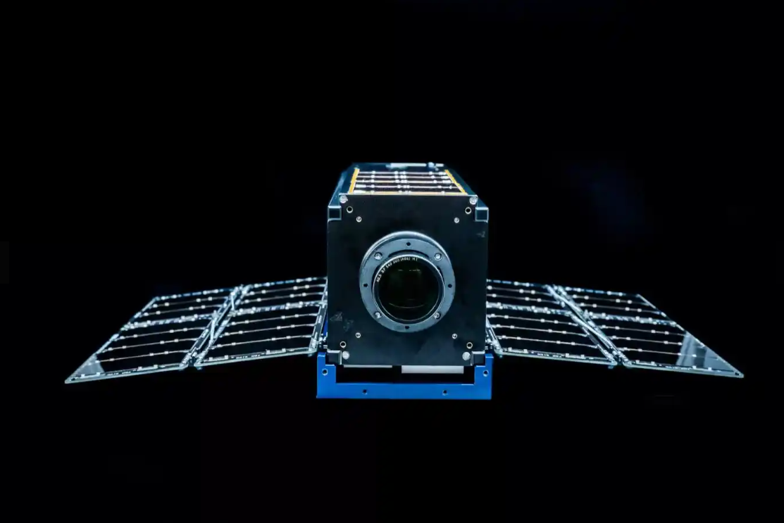
Air Force Research Lab Sponsor
Morse Code
Digital Demodulation
Remote code execution
Orbital tracking
CTF in Space
Moonlighter Satellite
Notes:
Yearly CTF to hack a satellite
Qualification in APRIL
Finals at Def Con
Our team placed 252 in qualification

Slide 4
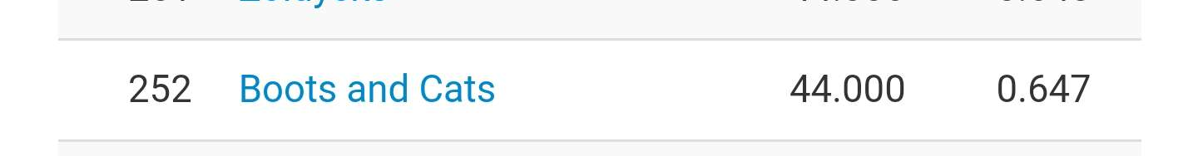
CTF in Space
Qualification Rank
Moonlighter Satellite
Notes:
Our team placed 252 in qualification

Slide 5
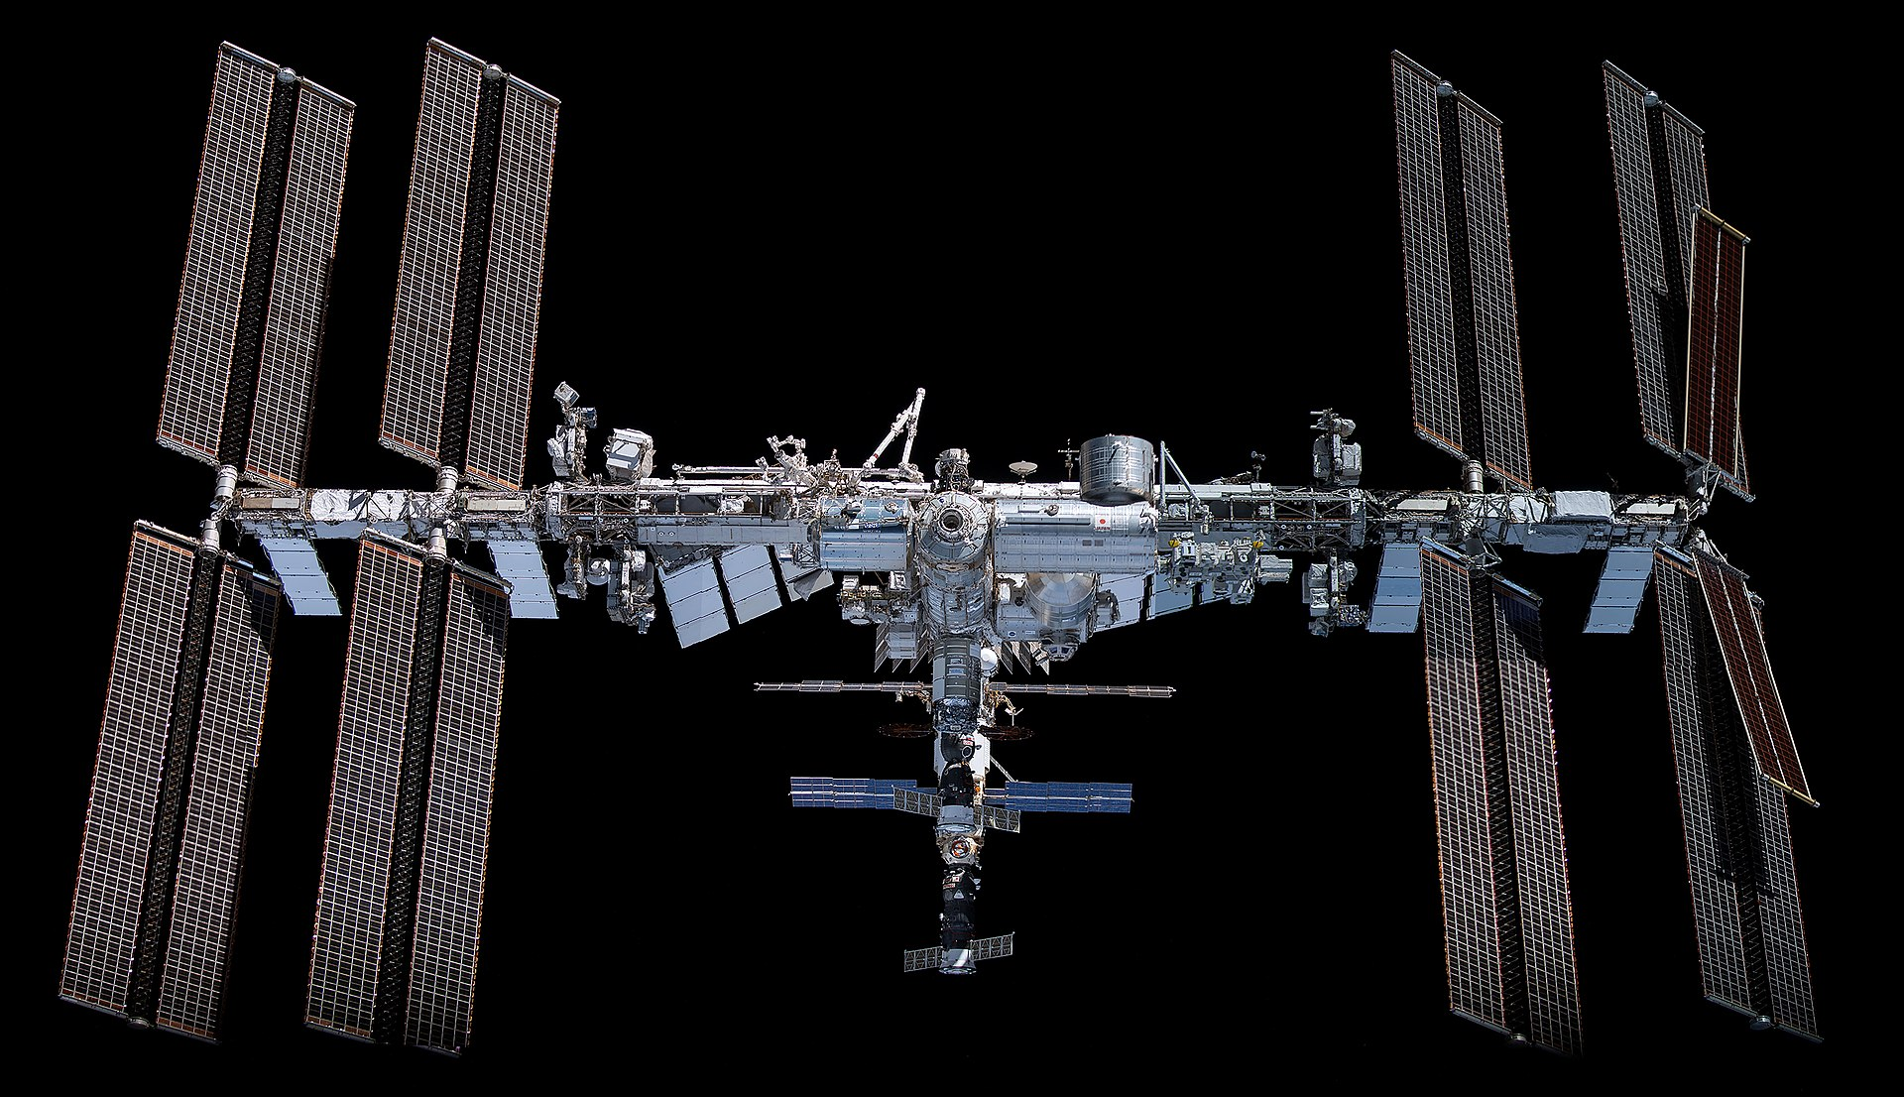
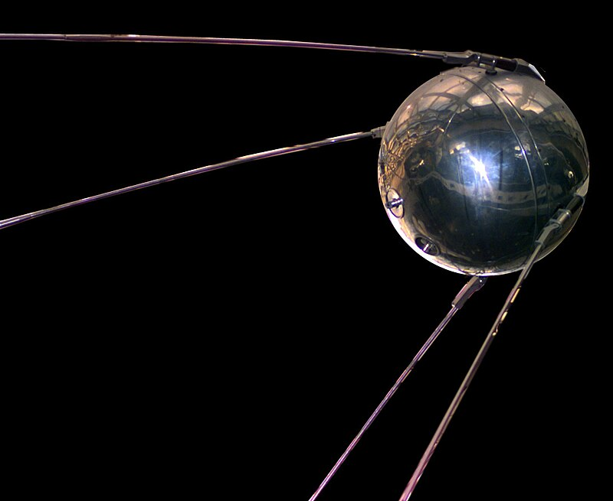
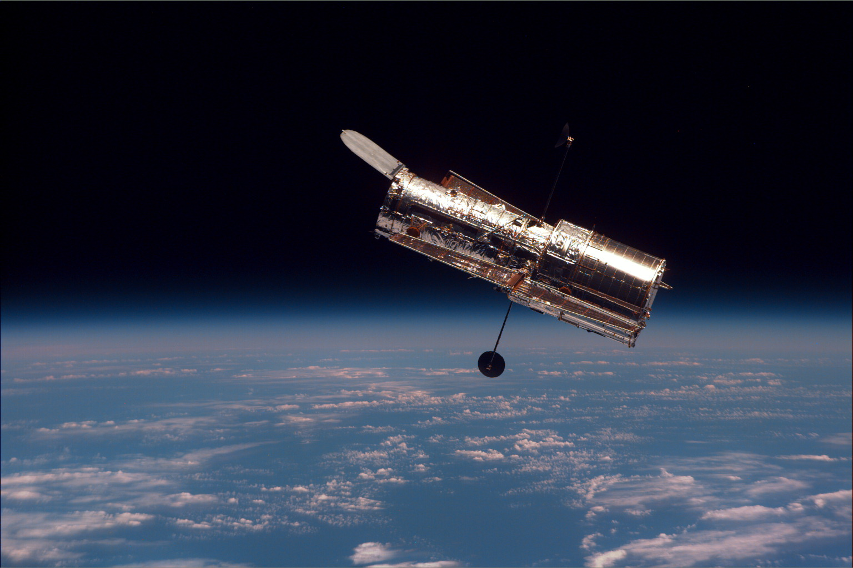
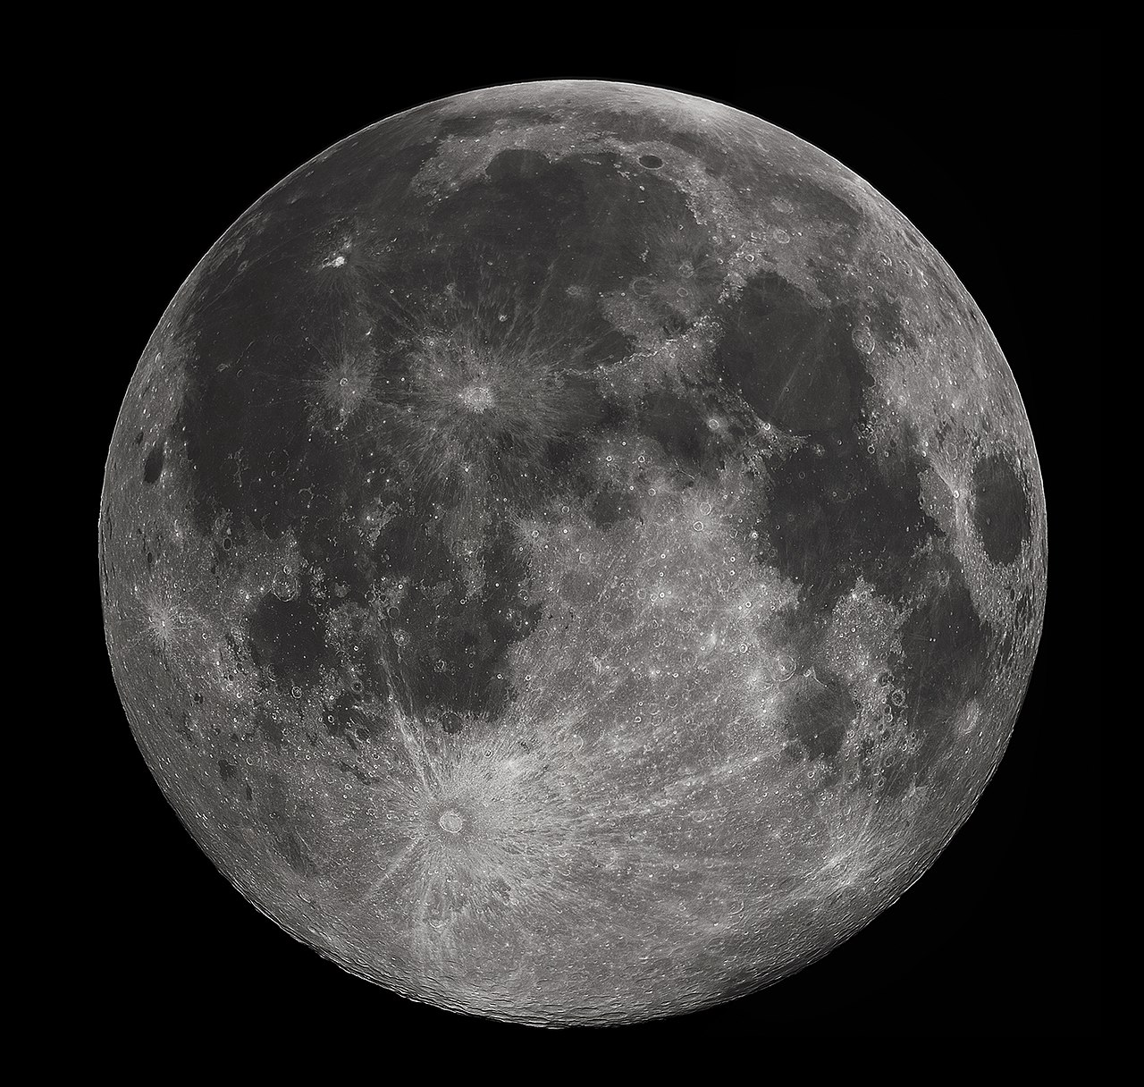

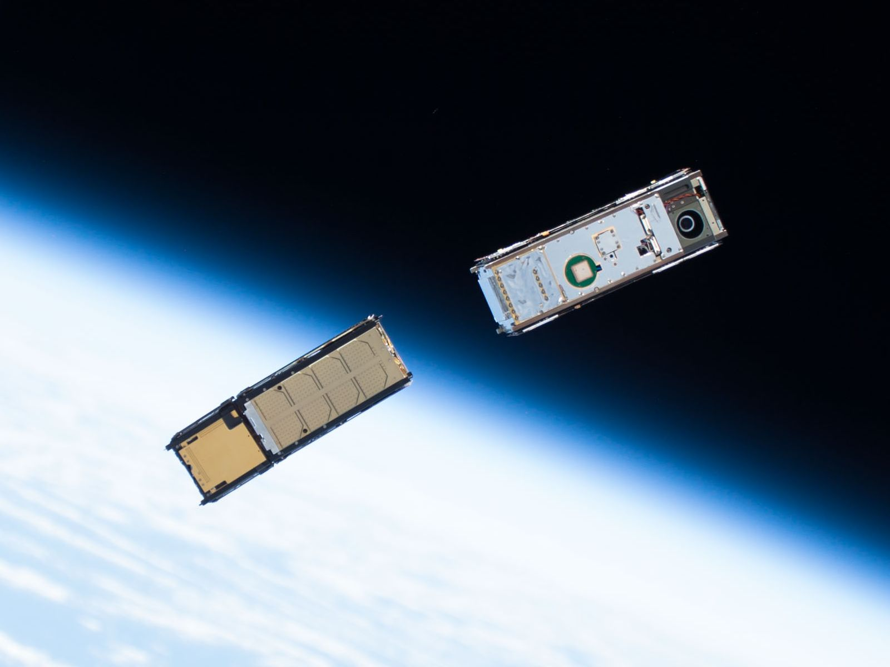
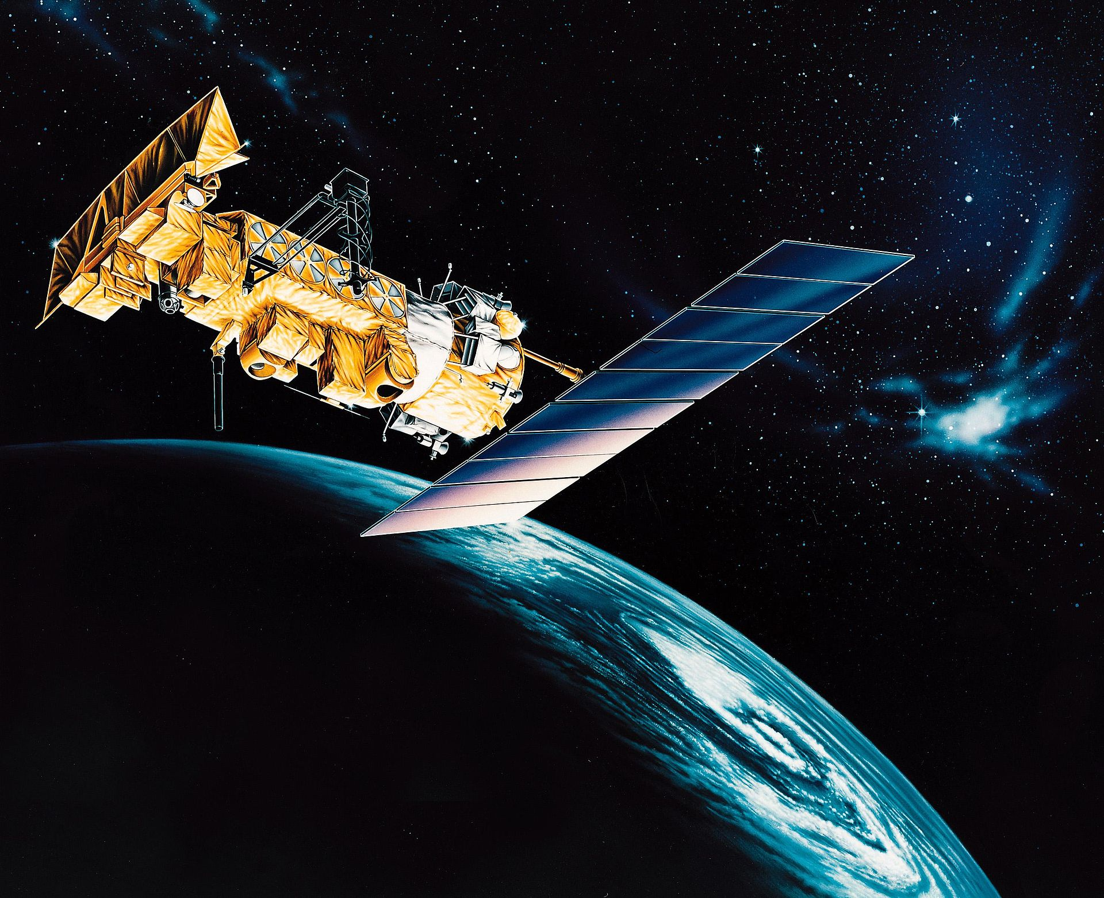

Satellites, how do they work?
Notes:
Satellites usually mean artificial satellites
Common uses: Communication, imaging, earth observation, navigation, reconnaissance
Most sats have electrical component. Passive sat - big ball PAGEOS

Slide 6

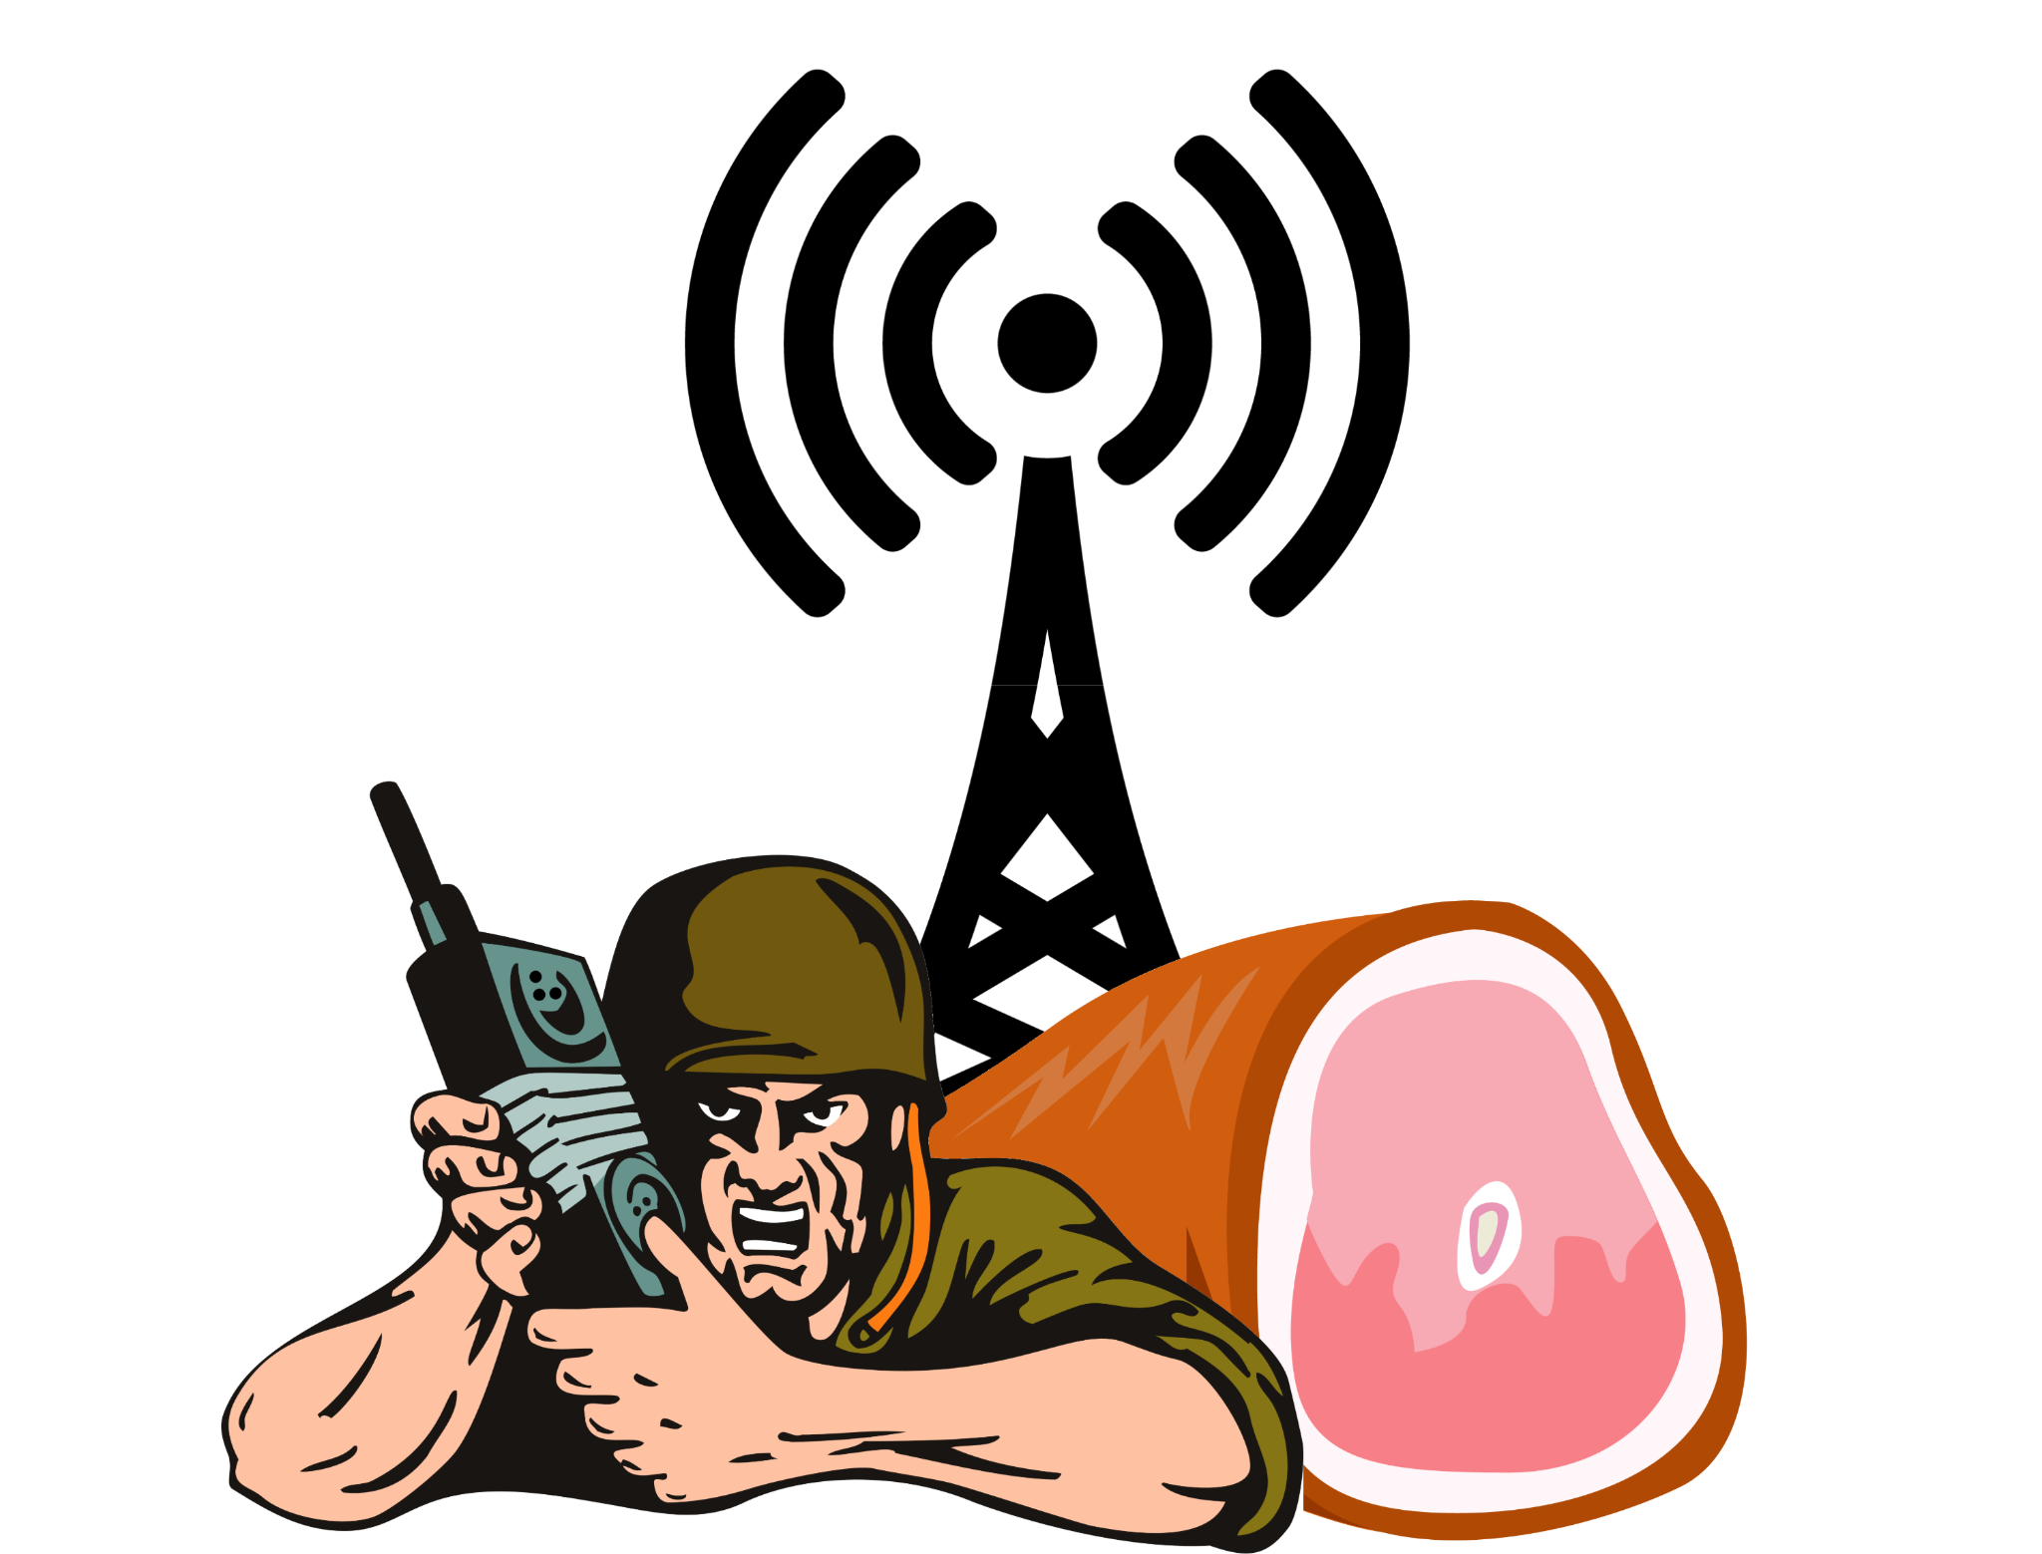
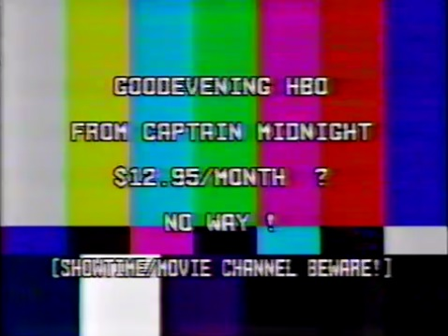
What can you do with Satellites?
Free Communications Relay
Listen to interesting signals
https://hamvillage.org/
Notes:
Common element to most satellites are radio
Mission is radio based
Command and control
Free communications relay
Legal: Amateur Radio
Free to use with a ham radio license
LEO, MEO and GEO
Illegal: Pirate satellites
Use transponders without permission
Listening:
Free TV
Satellite telemetry and mission status information
SpaceX telem and video was unencrypted until March 2021 https://twitter.com/r2x0t/status/1375472068595187722
Private moon landing

Slide 7
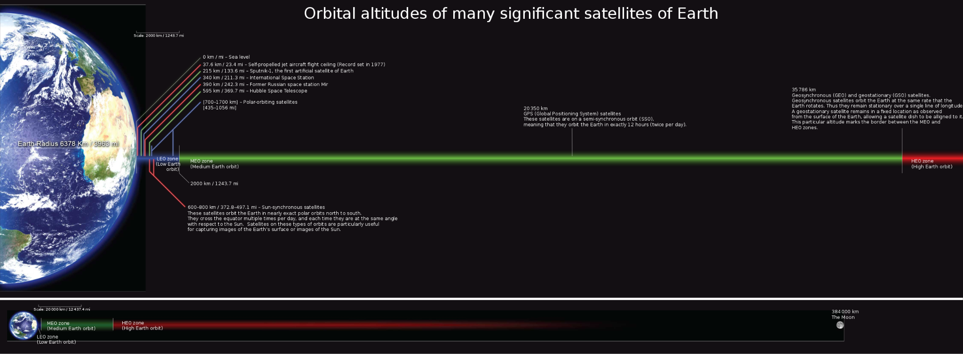
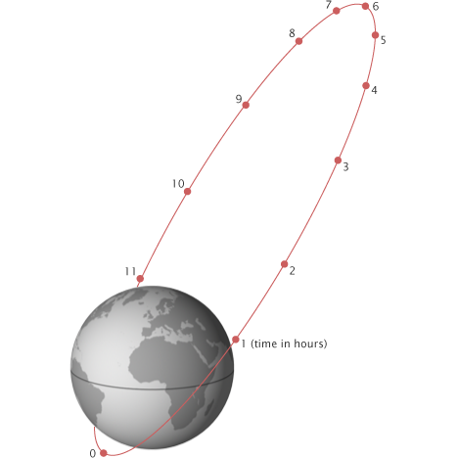
LEO: Low Earth Orbit < 1,200 Miles
MEO: Medium Earth Orbit 1,200 – 22,000 Miles
HEO: High Earth Orbit > 22,000 Miles
Mark Mercer, CC BY-SA 3.0, via Wikimedia Commons
https://earthobservatory.nasa.gov/features/OrbitsCatalog
Notes:
Three common orbits
LEO: Low earth orbit below 1,200 miles.
ISS is at 211 miles
MEO: Medium earth orbit
1,200 Miles to 22,000 miles
GPS satellites 12,500 miles
GEO: geosynchronouns and geostationary (GSO)
At 22,000 miles
HEO: High earth orbit
Above 22,000 miles
Molniya Orbit:
Russian for lightning
Coverage over polar region
3 satellites in a constellation for continuous coverage

Slide 8
Mark Mercer, CC BY-SA 3.0, via Wikimedia Commons
https://earthobservatory.nasa.gov/features/OrbitsCatalog
Notes:
Three common orbits
LEO: Low earth orbit below 1,200 miles.
ISS is at 211 miles
MEO: Medium earth orbit
1,200 Miles to 22,000 miles
GPS satellites 12,500 miles
GEO: geosynchronouns and geostationary (GSO)
At 22,000 miles
HEO: High earth orbit
Above 22,000 miles
Molniya Orbit:
Russian for lightning
Coverage over polar region
3 satellites in a constellation for continuous coverage

Slide 9
Mark Mercer, CC BY-SA 3.0, via Wikimedia Commons
https://earthobservatory.nasa.gov/features/OrbitsCatalog
Notes:
Three common orbits
LEO: Low earth orbit below 1,200 miles.
ISS is at 211 miles
MEO: Medium earth orbit
1,200 Miles to 22,000 miles
GPS satellites 12,500 miles
GEO: geosynchronouns and geostationary (GSO)
At 22,000 miles
HEO: High earth orbit
Above 22,000 miles
Molniya Orbit:
Russian for lightning
Coverage over polar region
3 satellites in a constellation for continuous coverage

Slide 10

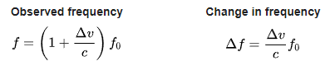
Doppler
Frequency of observed wave depends on the relative speed of the observer
Notes:
Waves appear compressed, higher frequency as source approaches
Spread out, lower frequency, as it moves away

Slide 11
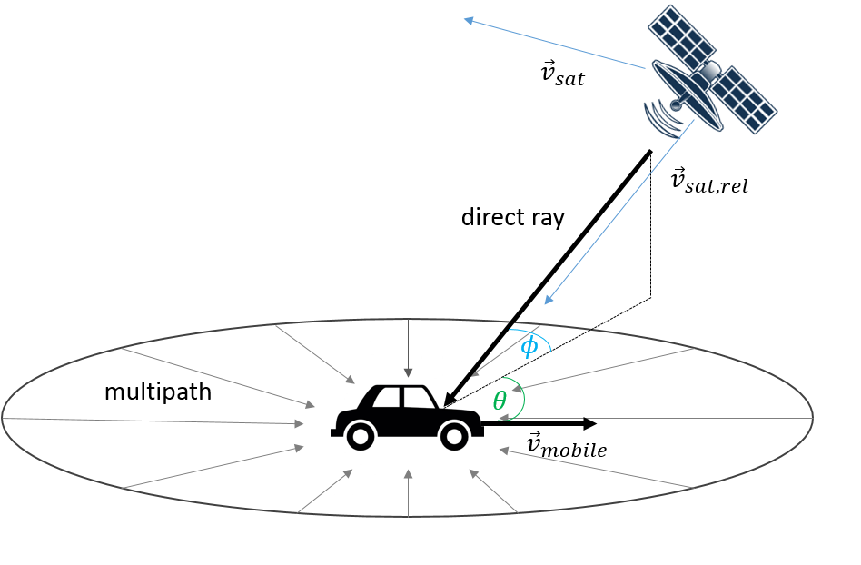
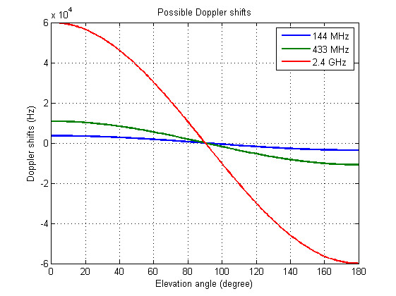
Doppler
Notes:
Satellites move fast enough to impact RF signals
As the satellite approaches the relative velocity is + at maximum speed when at AOS
When apogee, relative motion is 0 and no doppler shift
As moves away velocity - at maximum speed during LOS
Satellite communications need to correct for
uplink as seen by the satellite
Downlink as seen by the ground station

Slide 12
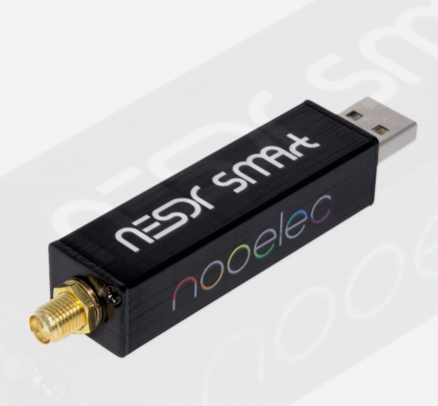
printf(“Hello world.”)
WX Satellite Reception
Satellite | Frequency
NOAA-15 | 137.6200 MHz
NOAA-18 | 137.9125 MHz
NOAA-19 | 137.1000 MHz
Notes:
Where to start?
WX Satellites are the hello world of satellite reception
Needed:
Receiver (traditional or SDR)
Antenna
Computer to decode

Slide 13
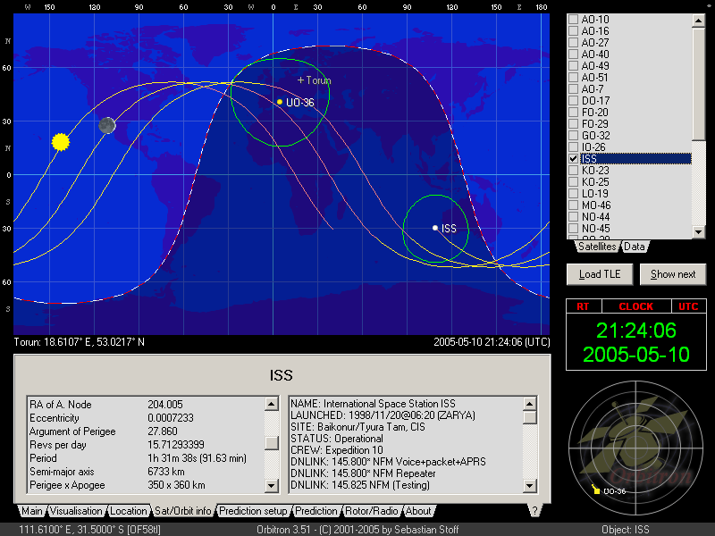
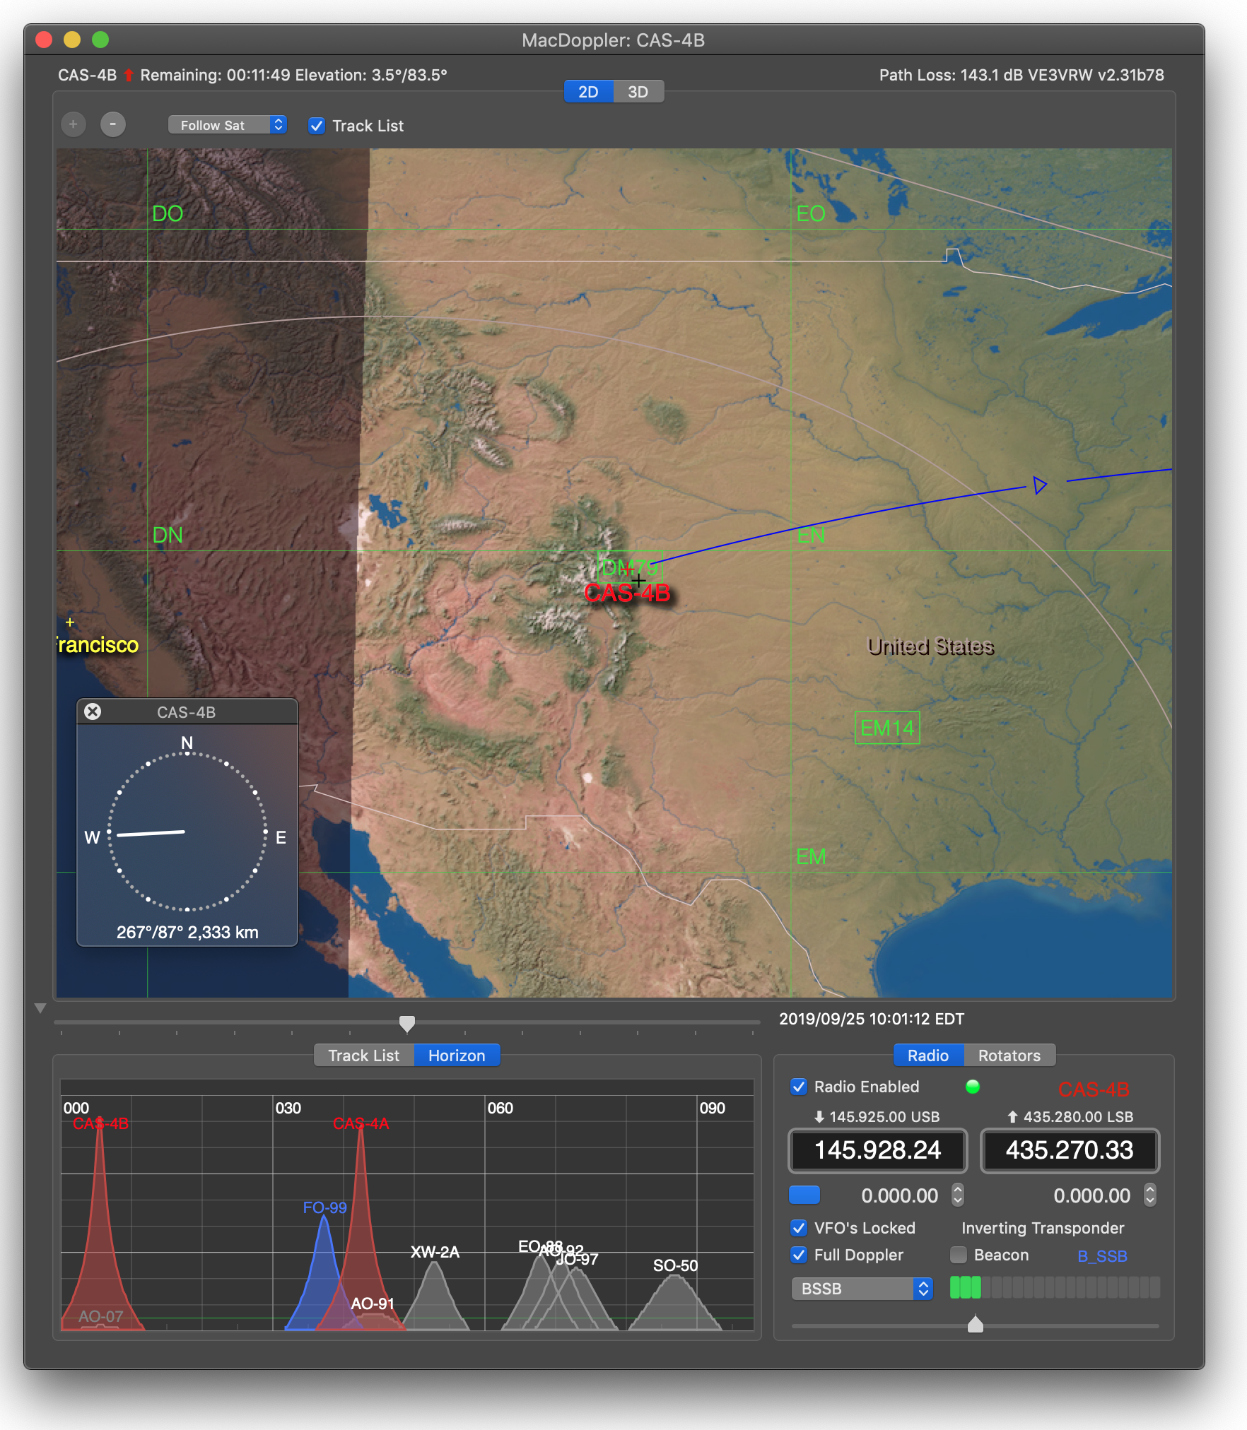
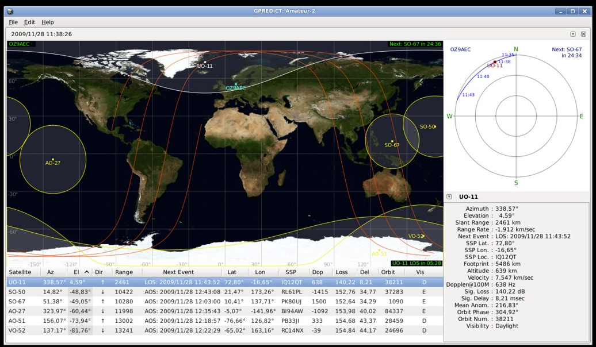
printf(“Hello world.”)
Where are they?
TLE: Two Line elements
Notes:
Software and websites available for satellite tracking
Gpredict - Linux
MacDoppler - Mac
Orbitron - Window
SatPC32 - Windows
Iss Detector - Android

Slide 14
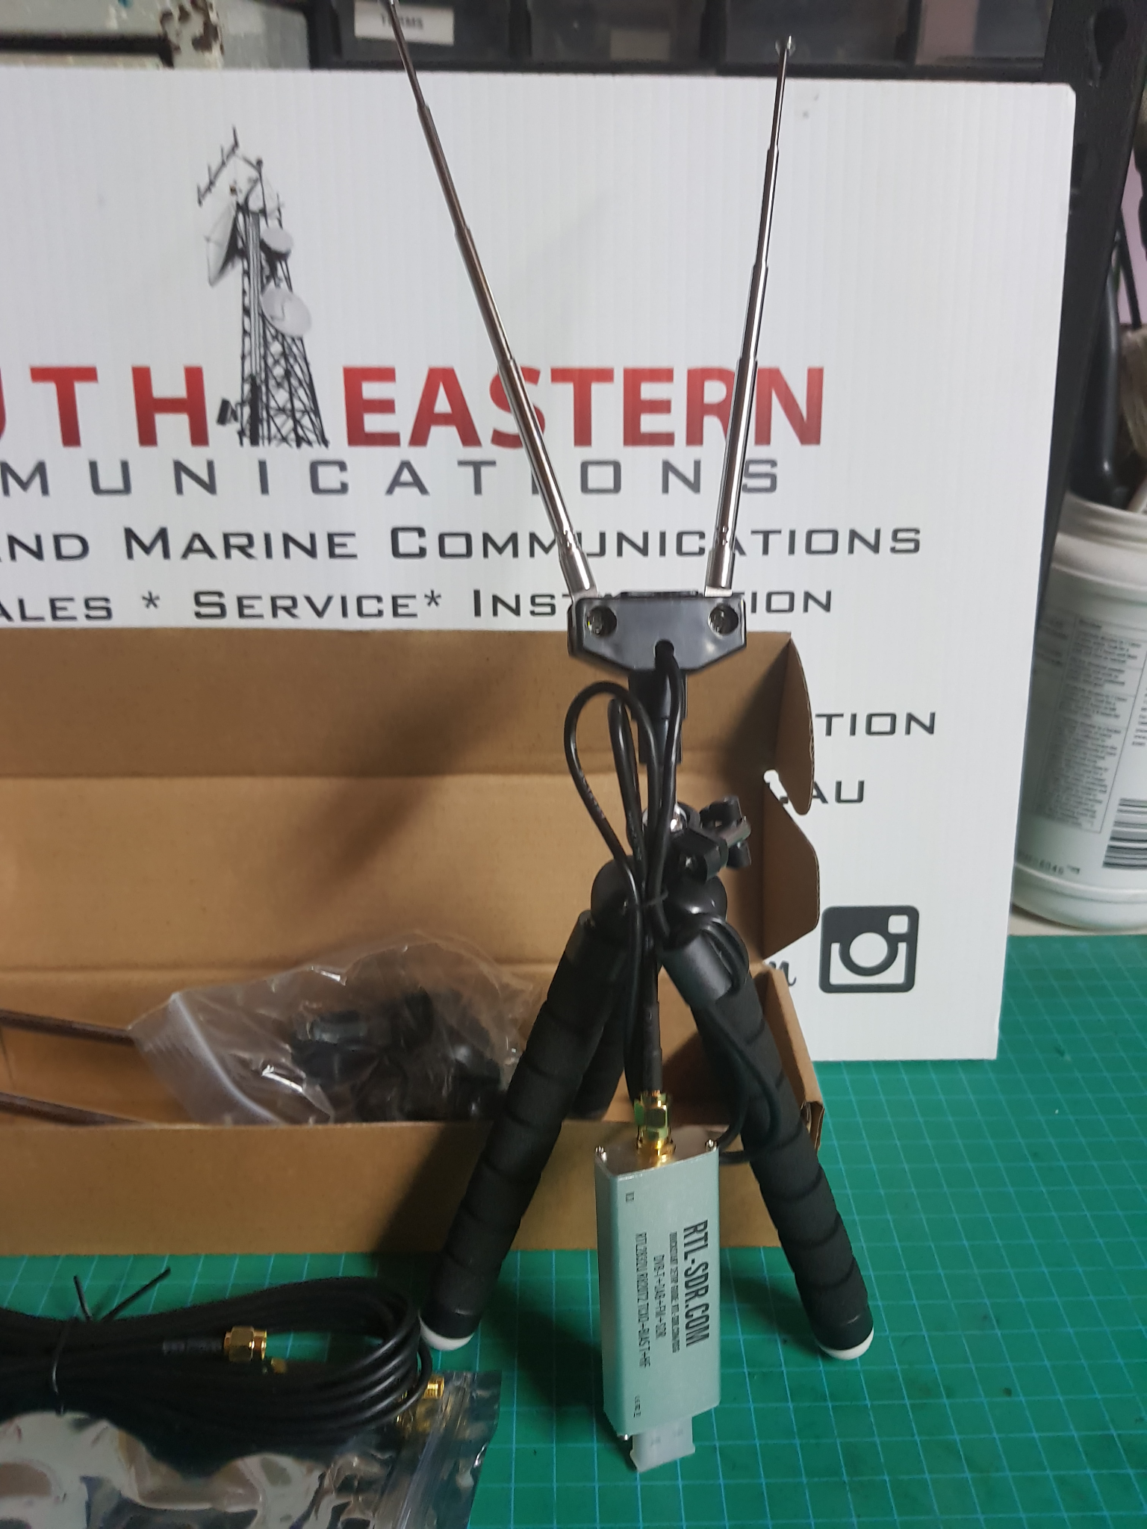
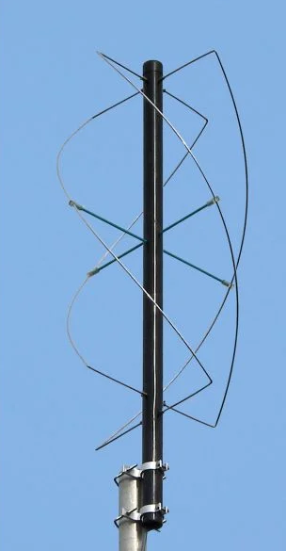
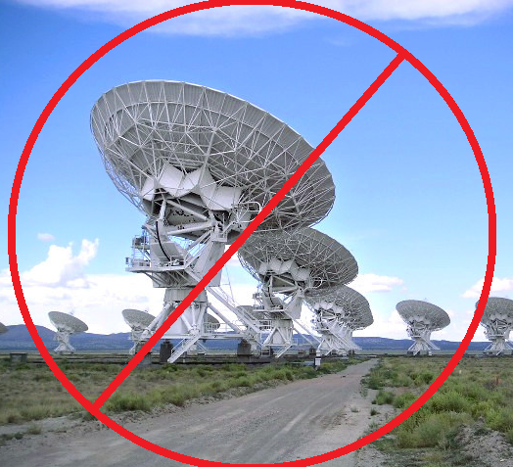
printf(“Hello world.”)
WX Satellite Antenna
Notes:
Doesn’t require expensive antennas
Needed:
Receiver (traditional or SDR)
Antenna
Computer to decode

Slide 15
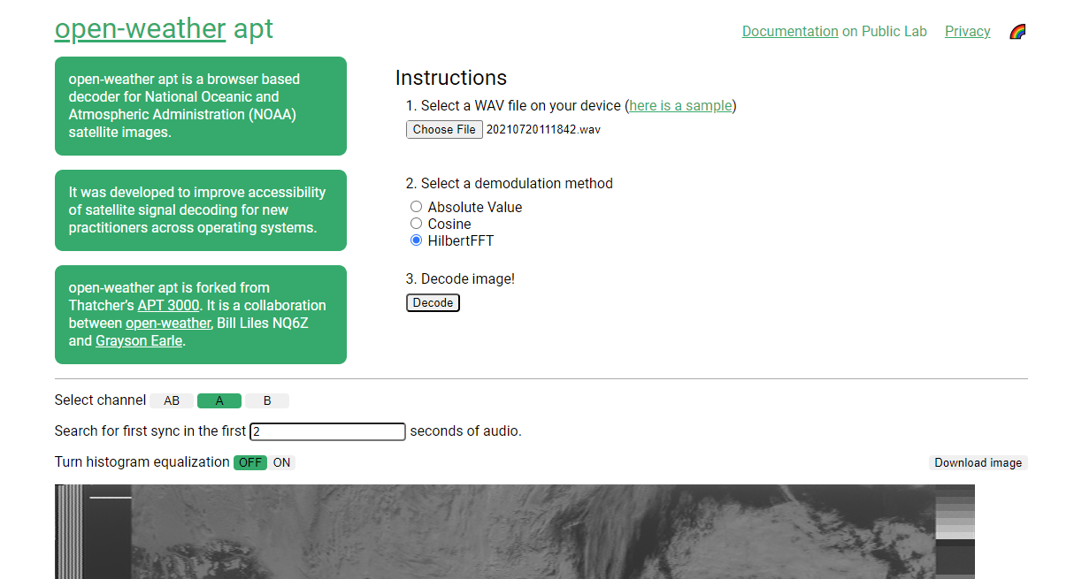
printf(“Hello world.”)
YouTube Tutorials
Instructables https://www.instructables.com/NOAA-Satellite-Signals-with-a-PVC-QFH-Antenna-and-/
Browser Based: https://apt.open-weather.community/
Notes:
Many tutorials available for Win/Linux/Mac
Instructable showing how to construct antenna
Browser based solutions

Slide 16
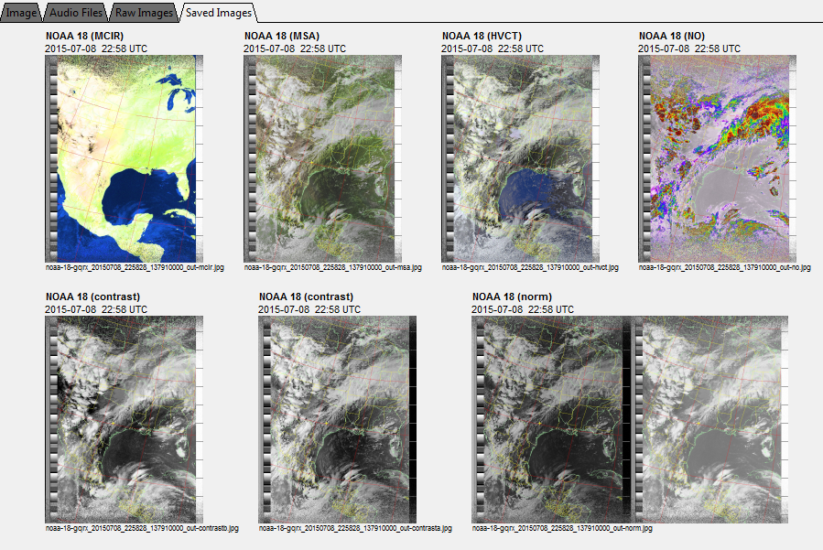
printf(“Hello world.”)
Image: https://www.instructables.com/NOAA-Satellite-Signals-with-a-PVC-QFH-Antenna-and-/

Slide 17
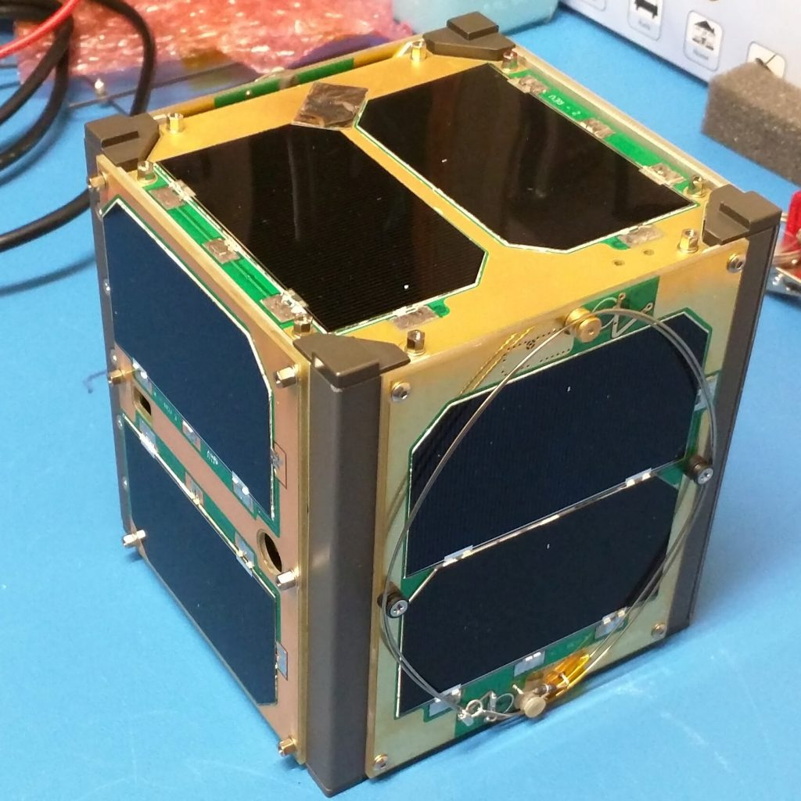
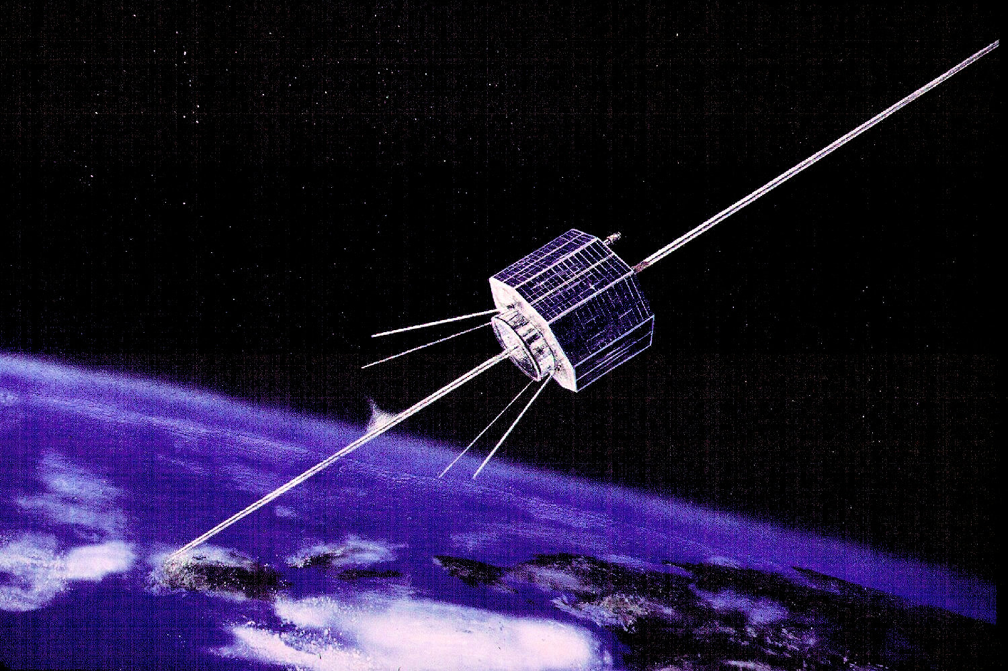
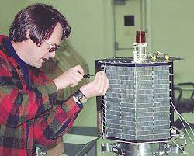
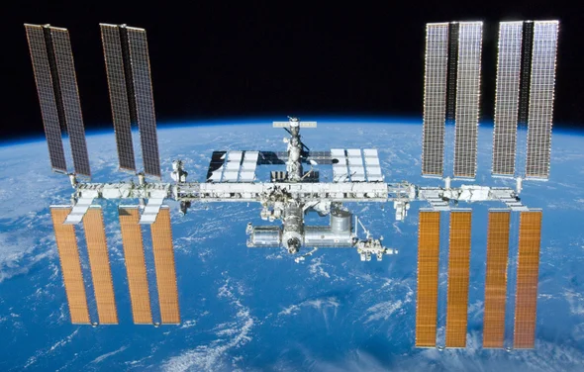
Ham Radio Satellites
Telemetry Only
FM Repeater
Linear Transponder
Digital Repeater
AO-91
AO-7
Notes:
Ham radio satellites are free and open to all licensed ham radio operators
Sizes range
Cube Sat 10cm^3 (less than 4inches)
ISS
Not just for ham radio
Multiple Modes of operation
Sometimes Astronauts will hop on the radio
AO-7
Launched in 1974
Failed in 1981, came back to life in 2002
Oldest operational communications satellite
Used by the anticommunist opposition Fighting Solidarity during martial law in Poland.
Several Operational modes
Telemetry only - Only transmits satellite stats
FM Repeater - works like terrestrial repeater.
One FM communication channel.
Easiest to use and most crowded/busy
Linear Transponder
Translates anything within one frequency range to another frequency range
Ron Burgundy of space
Digital Repeater
Decodes and repeats digital communications

Slide 18
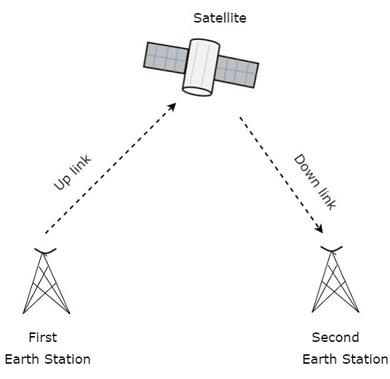
Ham Radio Satellites
FM Repeater Satellite Operation
Technically Easy / Operationally Hard
Has its own language
LEO footprint
Notes:
FM repeaters are the easiest
Single FM signal on uplink frequency
Satellite retransmits single FM signal on downlink frequency
Ham satellites use 145MHz up and 430 MHz down, or opposite
Technically Easy
Requires a hand held radio and antenna with moderate gain
Operationally Hard
Easy access means lots of people trying
Short contacts in a predetermined format

Slide 19
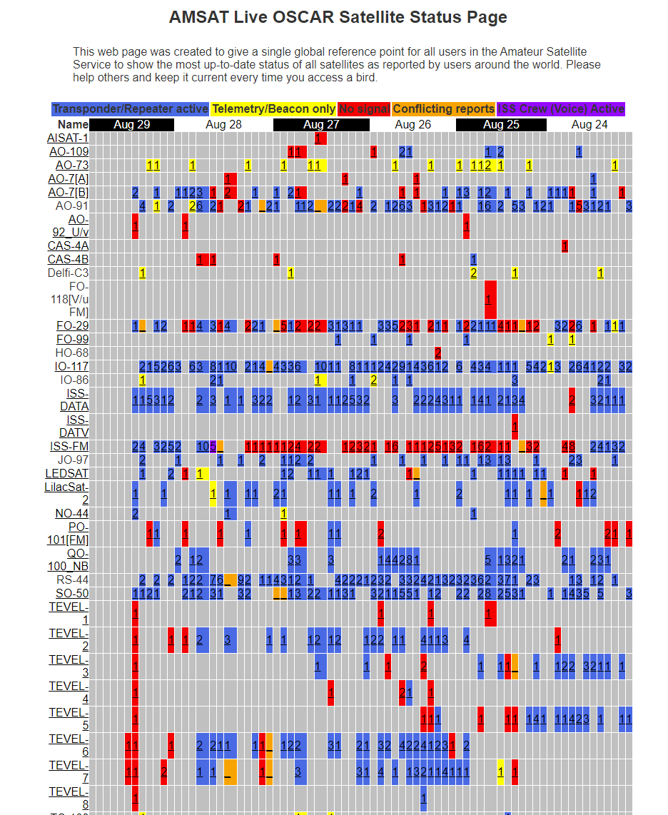
Ham Radio Satellites
https://www.amsat.org/status/
Search for frequency information
Check for upcoming passes
Notes:
Preparation for using satellites

Slide 20
Ham Radio Satellites
FM Repeater Satellite Operation
ISS REPEATER
Memory CH | TX Freq | TX CTCSS | RX Freq
n | 145.990 MHz | 67.0 Hz | 437.810 MHz
n+1 | 145.990 MHz | 67.0 Hz | 437.805 MHz
n+2 | 145.990 MHz | 67.0 Hz | 437.800 MHz
n+3 | 145.990 MHz | 67.0 Hz | 437.895 MHz
n+4 | 145.990 MHz | 67.0 Hz | 437.890 MHz
Notes:
Configure memory channels for each FM satellite you want to operate
Some will have turn on tones
you’ll probably never need this

Slide 21
Ham Radio Satellites
FM Repeater Satellite Operation
ISS REPEATER
Memory CH | TX Freq | TX CTCSS | RX Freq
n | 145.990 MHz | 67.0 Hz | 437.810 MHz
n+1 | 145.990 MHz | 67.0 Hz | 437.805 MHz
n+2 | 145.990 MHz | 67.0 Hz | 437.800 MHz
n+3 | 145.990 MHz | 67.0 Hz | 437.895 MHz
n+4 | 145.990 MHz | 67.0 Hz | 437.890 MHz
Notes:
Configure memory channels for each FM satellite you want to operate
Some will have turn on tones
you’ll probably never need this

Slide 22
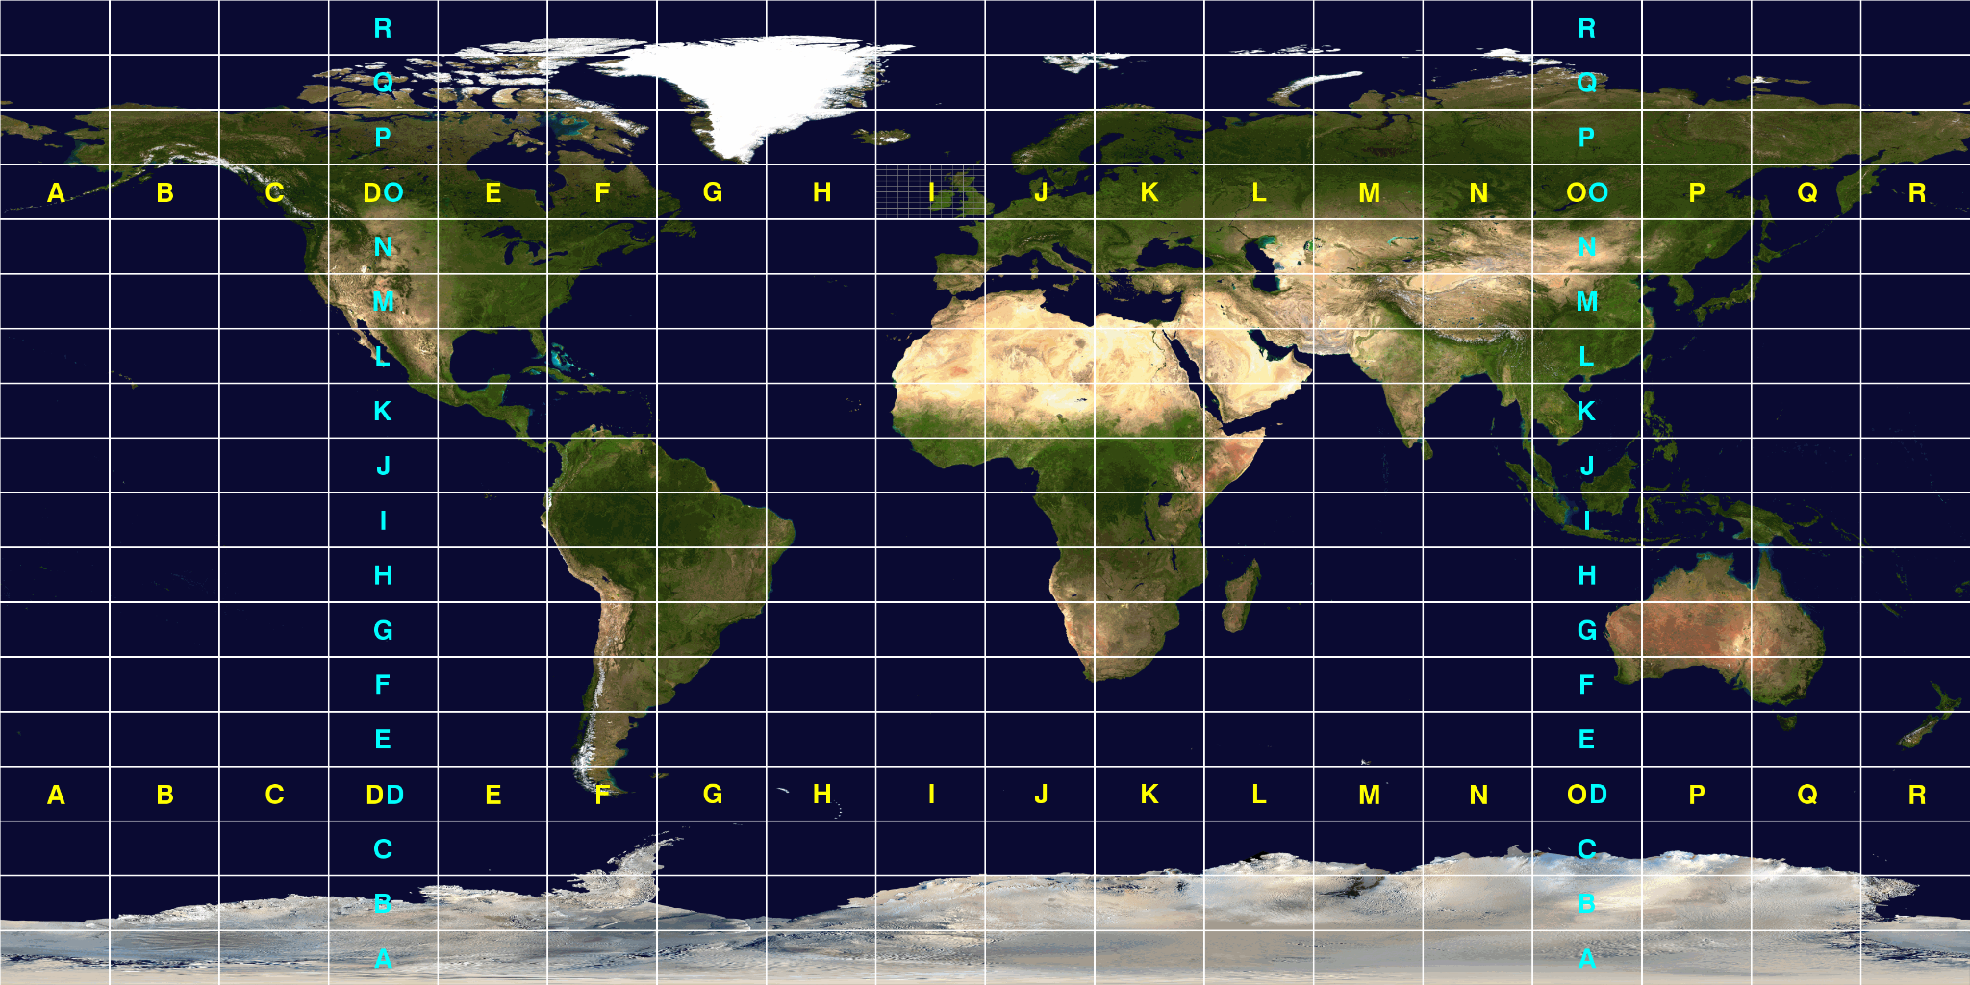
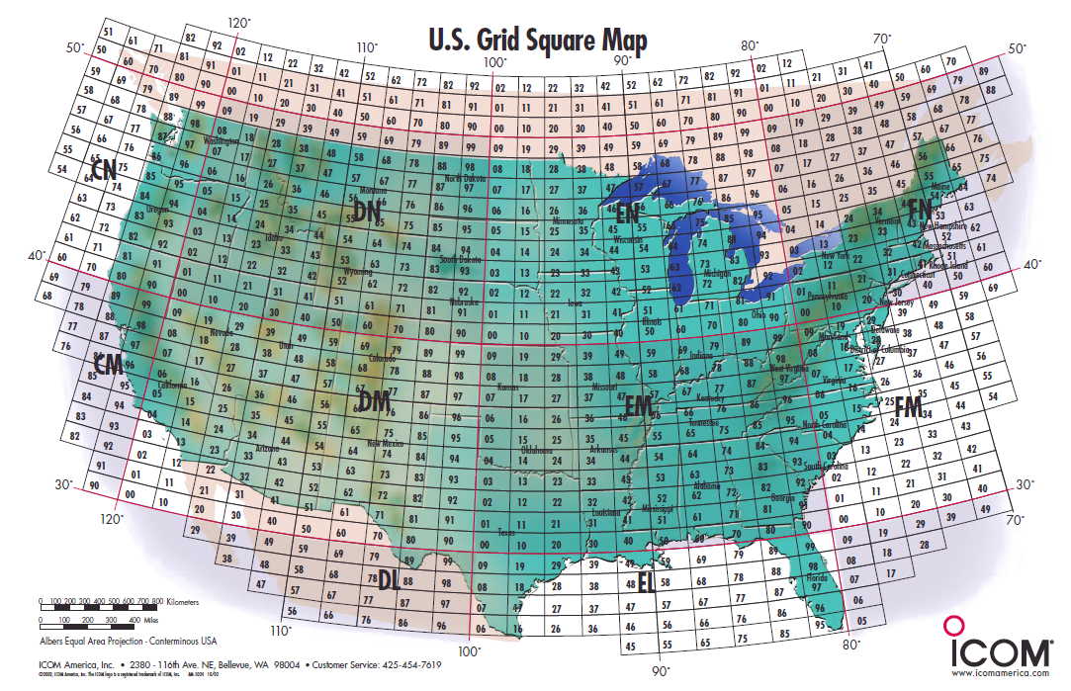
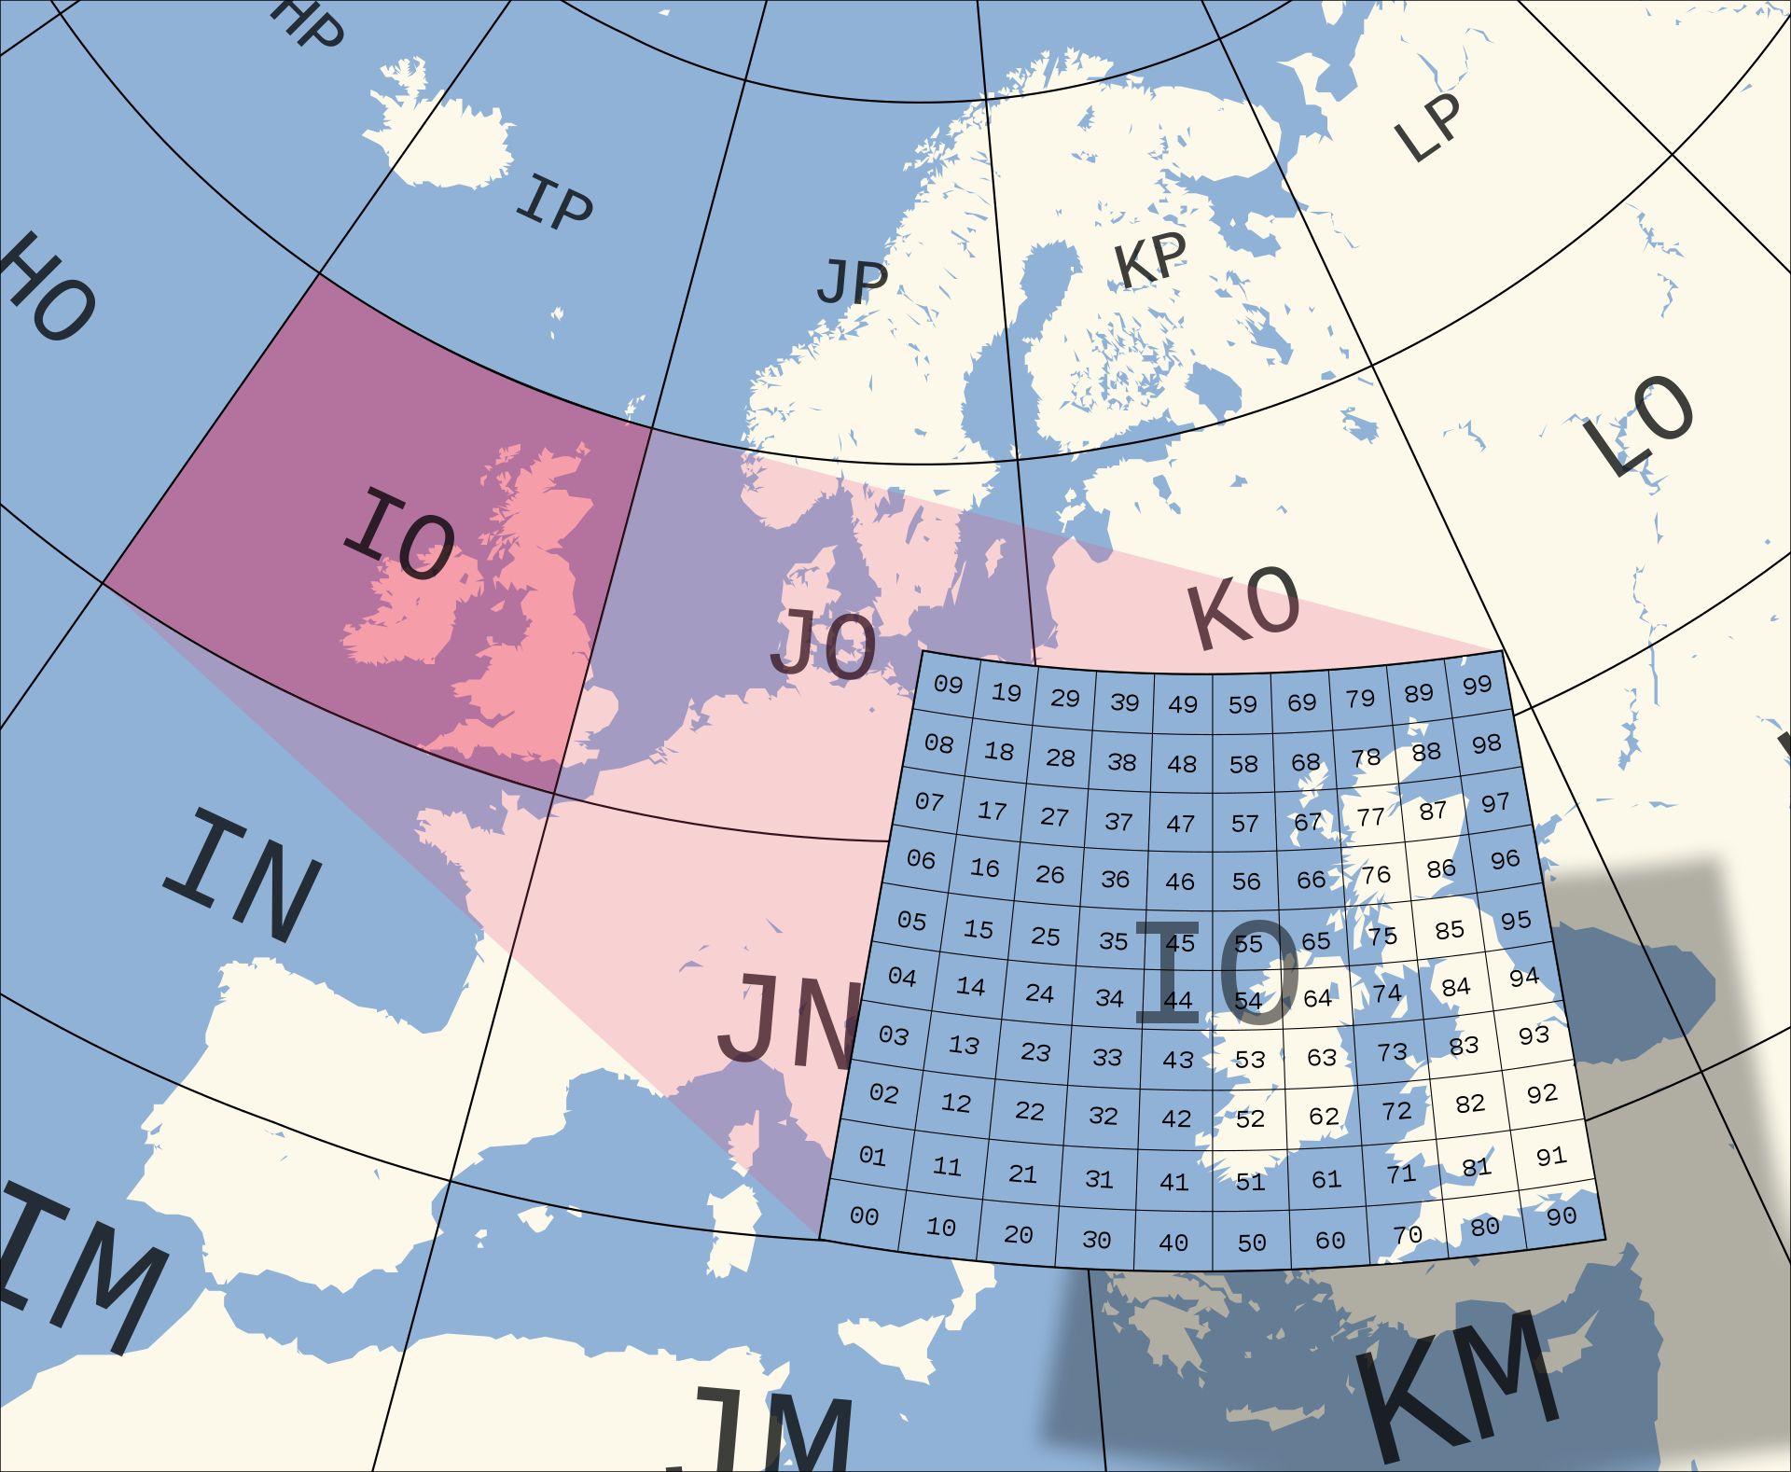
Ham Radio Satellites
FM Repeater Satellite Operation
Notes:
TODO: ADD CONTACT AUDIO

Slide 23

Notes:
TODO: ADD CONTACT AUDIO

Slide 24
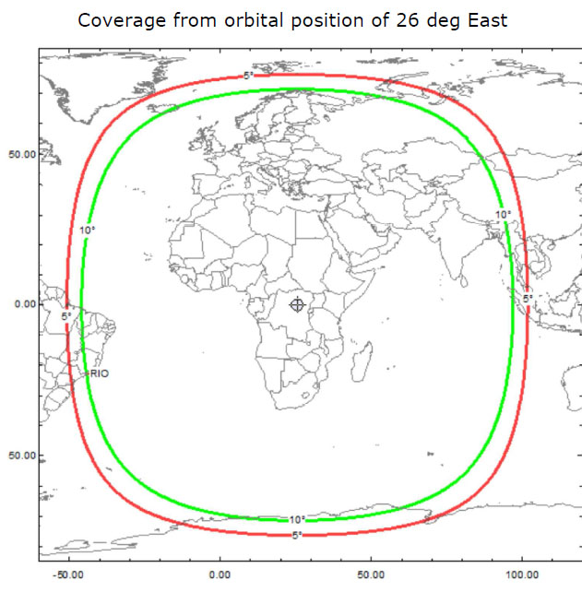
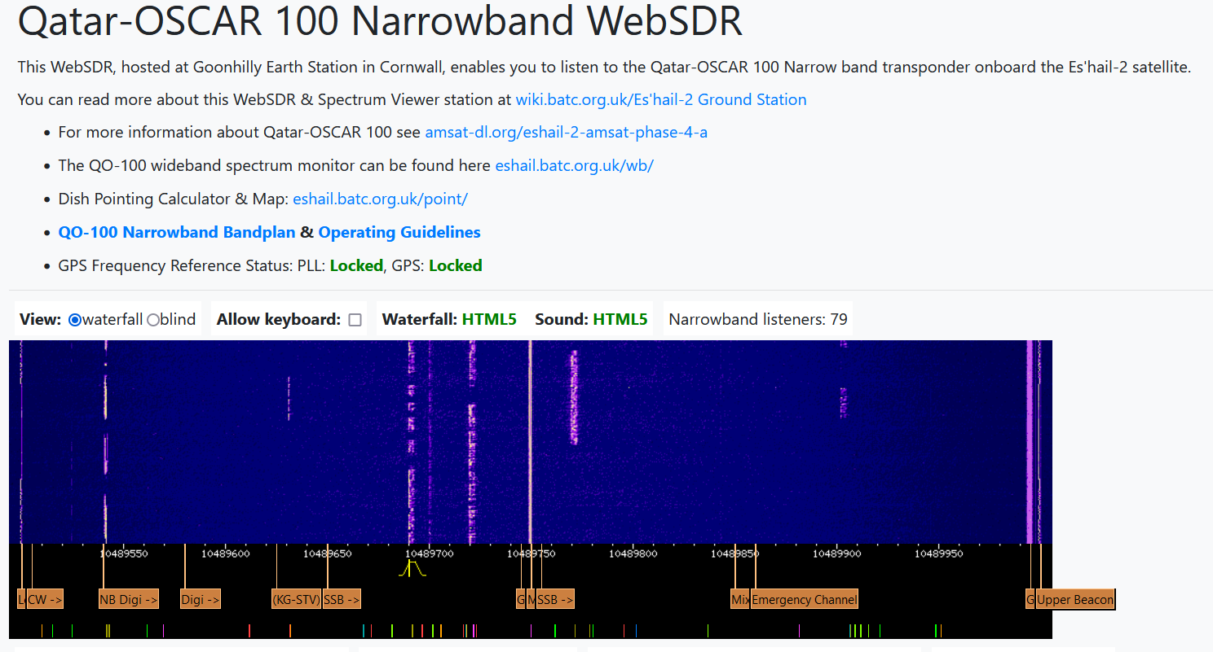
Ham Radio Satellites
QO-100
Online Receiver: https://eshail.batc.org.uk/nb/
Notes:
Qatat-OSCAR 100
Geostationary
Narrowband and wideband transponder 2.4GHz up and 10 GHz down
Can send voice and video signals
https://eshail.batc.org.uk/nb/

Slide 25
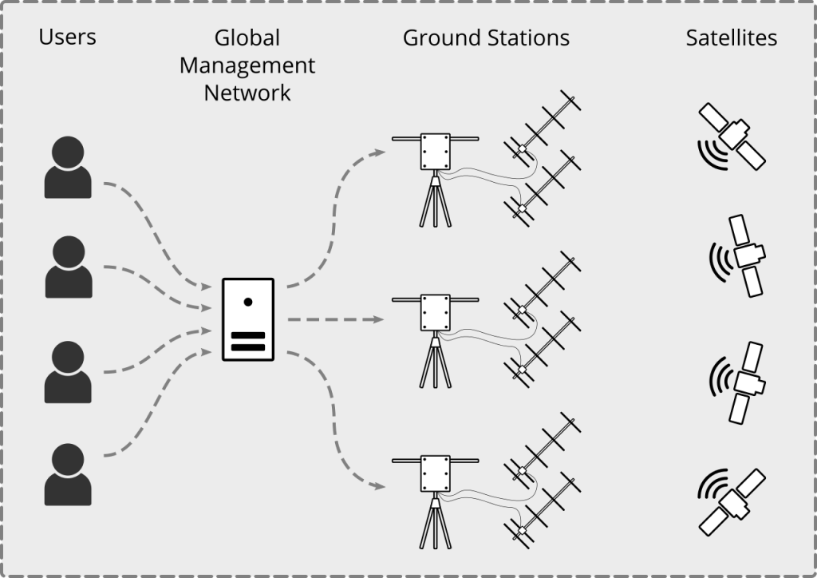
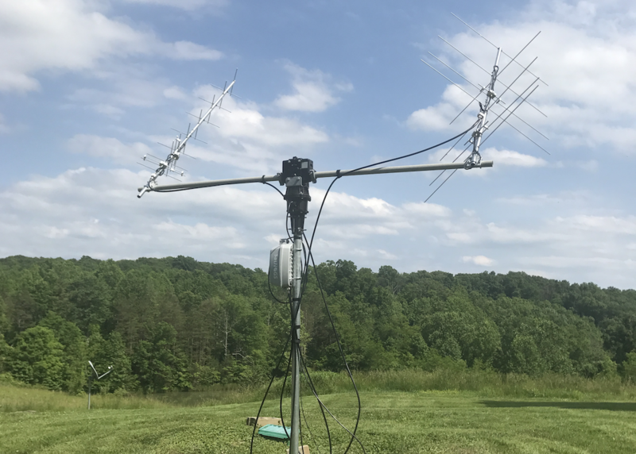
Receive Only
SatNOGS
Notes:
SatNOGS network of satellite ground stations
Others can use you station for observation when you’re not using it
Requirements: Rpi and RTLSDR

Slide 26
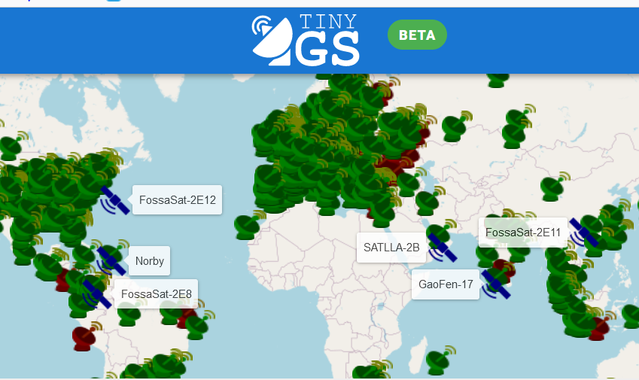
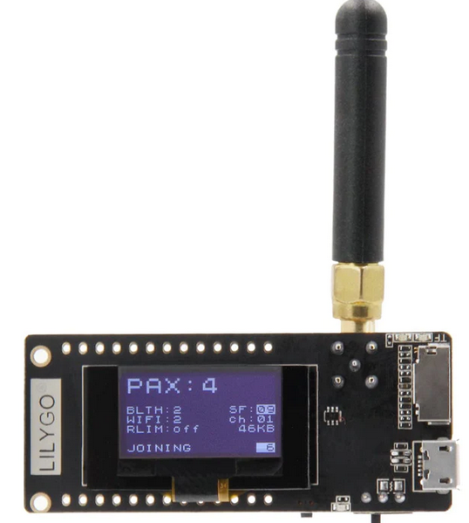
Receive Only
TinyGS
Notes:
Network of receivers like SatNOGS
For LoRa satellites

Slide 27
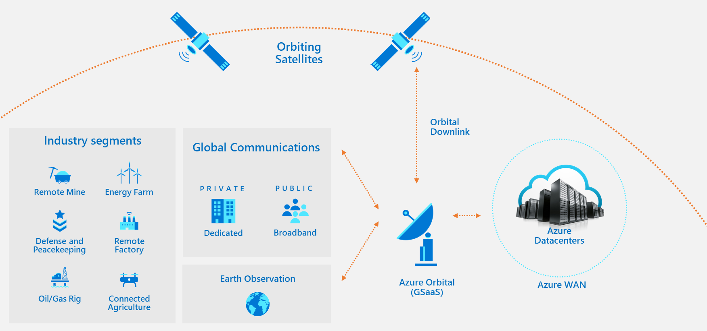
GSaaS
AWS and Azure
Notes:
Ground Station As A Service from Microsoft and Amazon
Other providers
Leaf space
KSAT

Slide 28
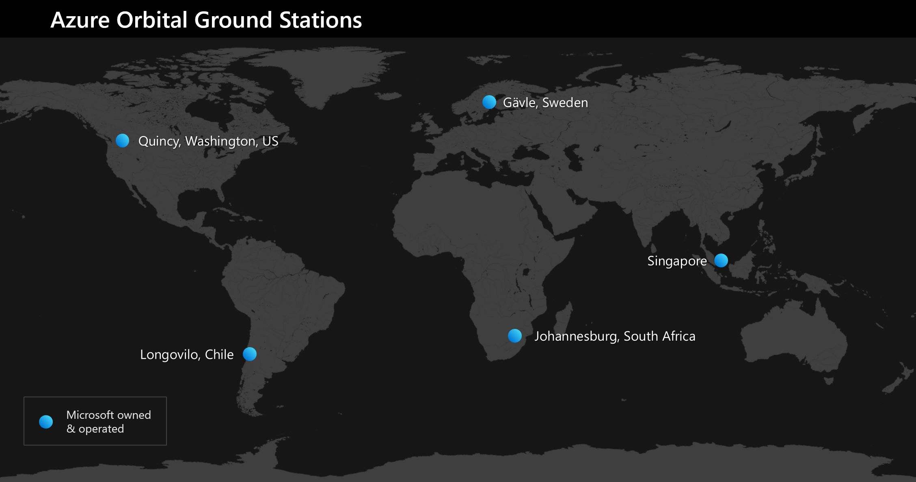
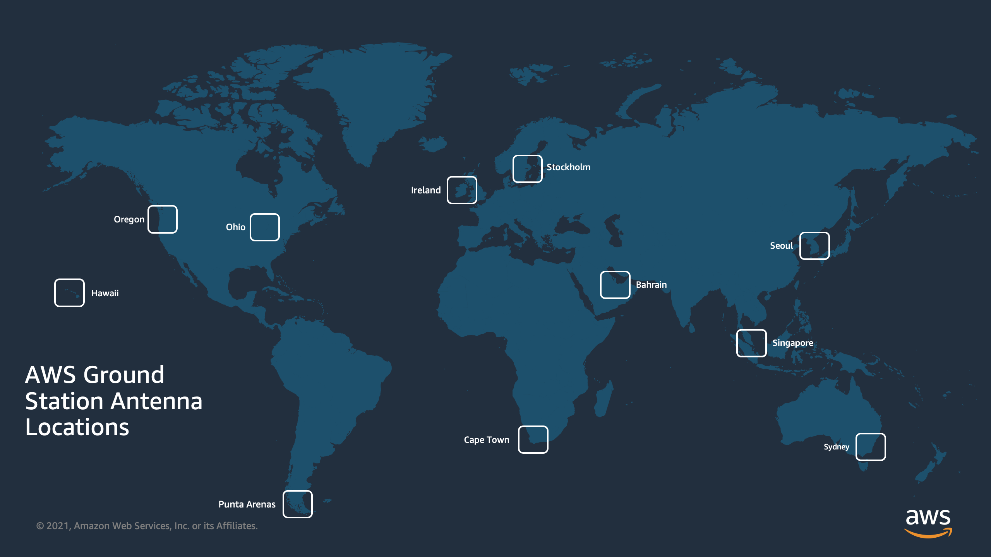
GSaaS
S-Band
X-Band

Slide 29
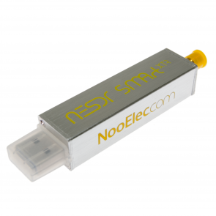
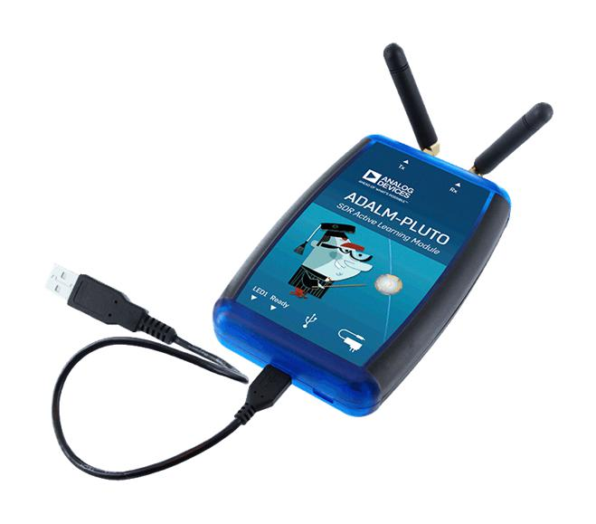

GNU Radio projects
gr-iridium
gr-satellites
Notes:
gr-iridum: iridium burst detector and demodulator
Iridum satellites used for message services and phone calls
ACARS messages
gr-satellites: collection of telemetry decoders that supports many different amateur sats
Used for building blocks to implement other satellite decoders

Slide 30
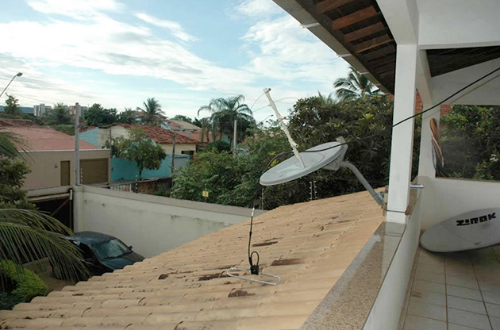
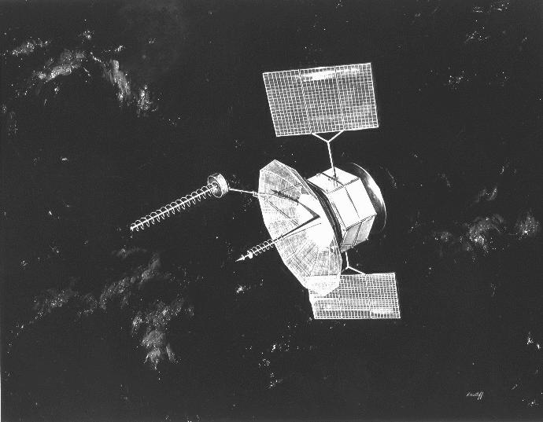
Military Satellites
UHF 240-270 MHz
https://uhf-satcom.com/
https://www.wired.com/2009/04/fleetcom/
Notes:
UHF milsats
Can be heard with scanner
Fleetsat 8 Navy Sat
Brazil pirates
Sometimes legitimate operators in the clear: Operation Deepfreeze calling back to McCord

Slide 31
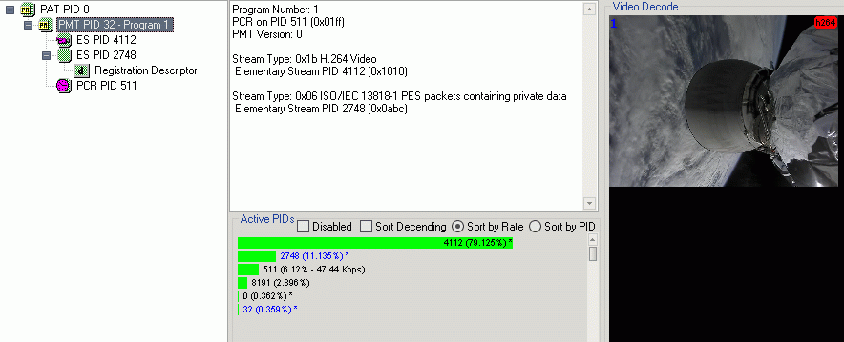
SpaceX Telemetry
r00t (@r2x0t)
Notes:
April 2021
R00t was able get spacex telemetry
Spacex and DOD wasn’t happy, encrypted

Slide 32
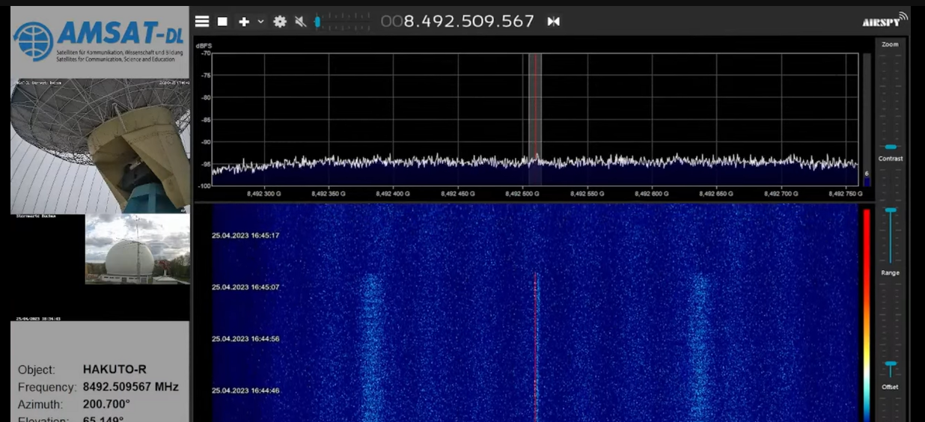
HAKUTO-R
Notes:
Hah-ku-toe
HAKUTO-R private moonlander
April 25 2023

Slide 33
Russian Military Satellites
MERIDIAN
Linear Transponders

Slide 34
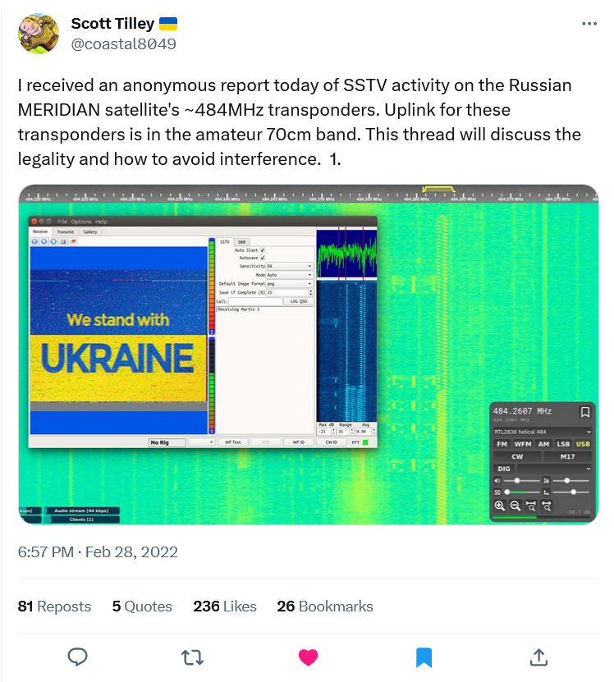
Russian Military Satellites
Remember kids, intentional interference is illegal!

Slide 35
Russian Military Satellites
Remember kids, intentional interference is illegal!
MERIDIAN 7 [40296, 2014-069A] MERIDIAN 8 [44453, 2019-046A] MERIDIAN 9 [45254, 2020-015A]

Slide 36
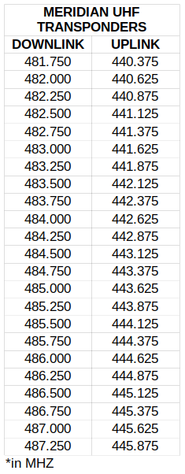
Russian Military Satellites
MERIDIAN 7 [40296, 2014-069A] MERIDIAN 8 [44453, 2019-046A] MERIDIAN 9 [45254, 2020-015A]

Slide 37
Get started
WX Sat Instructable: https://www.instructables.com/NOAA-Satellite-Signals-with-a-PVC-QFH-Antenna-and-/
Satellite Status Page: https://www.amsat.org/status/
SatNOGS: https://satnogs.org/
TinyGS: https://tinygs.com/
Scott Tilley: https://twitter.com/coastal8049
SpaceX Telem: https://www.r00t.cz/Sats/Falcon9
Slides: https://github.com/Reid-n0rc/SecKC-Sep23-Satellites

